Slide 1


PROJECT :- Sales Forecasting Across Multiple Retail Stores
Name:- AMAN SHARMA

Slide 2


Slide 3
STEPS IN SUMMARIZING THE DATA PROCESS
Task 1 - Exploration of customer purchasing Behaviour.
Task 2 - Prediction of store sales .
Task 3 - Serving predictions on a web interface .

Slide 4
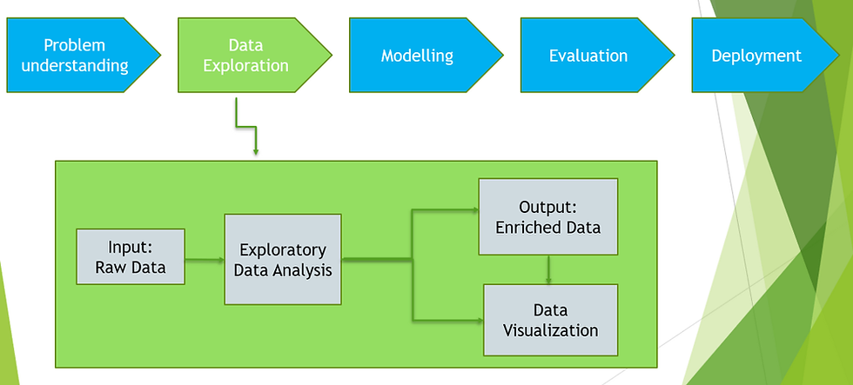
OBJECTIVE

Slide 5
PROJECT OVERVIEW
To develop and deploy an end-to-end machine learning solution that forecasts daily sales for retail stores across multiple cities up to six weeks in advance.
Business Problem
Currently, store managers rely on personal experience and judgment to forecast sales, which may not be optimal. The finance team requires accurate sales predictions to make informed business decisions and resource planning across various store locations.
Project Objectives
The project is structured into three main components
1. Exploratory Data Analysis (Task 1)
.Customer Behavior Analysis: Understanding purchasing patterns across different stores.
.Data Cleaning & Preprocessing: Building pipelines to handle outliers and missing data.
.Feature Analysis: Examining factors like promotions, holidays, seasonality, competition, and store characteristics.

Slide 6
Key to Explore:
Impact of promotions on sales and customer acquisition
Seasonal purchasing behaviors (Christmas, Easter, etc.)
Correlation between sales and customer numbers
Effect of competition distance on store performance
Store opening patterns and weekend sales impact
2. Predictive Modeling (Task 2)
Traditional ML Approach: Using sklearn pipelines with tree-based algorithms (Random Forest)
Deep Learning Approach: Implementing LSTM neural networks for time series forecasting
Feature Engineering: Creating temporal features from datetime columns
Model Evaluation: Custom loss function selection and performance analysis
MLOps Implementation: Model serialization, versioning, and MLFlow integration
3. Web Application Development (Task 3)
Frontend Interface: User-friendly dashboard
Backend Development: Model inference using Streamlit
Input Parameters: Store ID, date, holiday indicators, promotion status
Output Features: Predicted sales amounts, customer numbers, and downloadable CSV reports

Slide 7
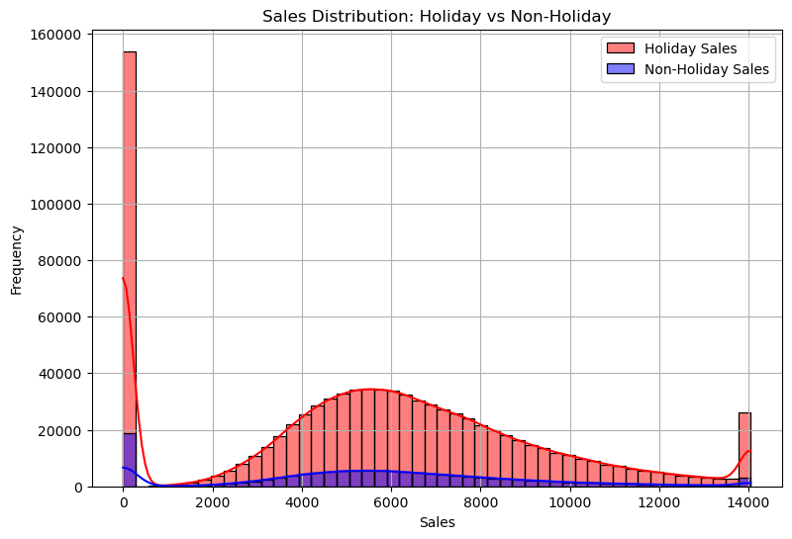
Task 1 - Exploration of customer purchasing Behaviour
Exploratory data analysis is the lifeblood of every meaningful machine-learning project. It helps us unravel the nature of the data and sometimes informs how you go about modelling. A careful exploration of the data encapsulates checking all available features, checking their interactions and correlation as well as their variability with respect to the target. In this task, you seek to explore the behaviour of customers in the various stores. Our goal is to check how some measures such as promos and opening of new stores affect purchasing behavior. To achieve this goal, you need to first clean the data. The data cleaning process will involve building pipelines to detect and handle outlier and missing data. This is particularly important because you don’t want to skew our analysis.

Slide 8
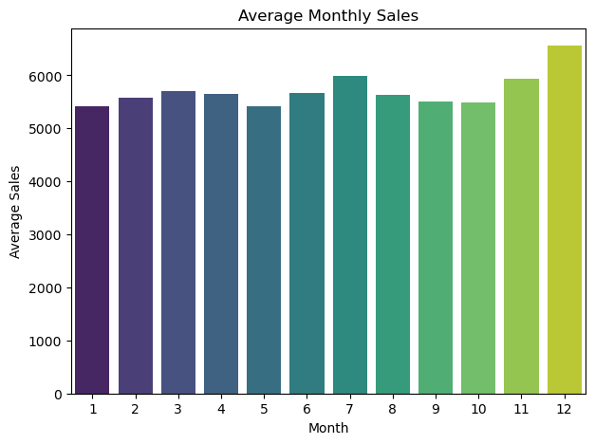
Average Monthly Sales
Highest Average Sales: December stands out with the bright yellow bar, indicating the peak of sales activity possibly driven by holiday shopping or end-of-year promotions.
Lowest Average Sales: May records the lowest sales with a darker bar, suggesting a seasonal dip or off-peak customer activity.
Gradual Trend: The months leading to December show a general upward movement in sales, hinting at increasing customer engagement or seasonal campaigns as the year progresses
Marketing Focus: Leverage data-driven campaigns pre-December and address underperforming months with creative initiatives.
Customer Segmentation: Consider timing discounts based on buyer categories early planners vs last-minute shoppers.

Slide 9
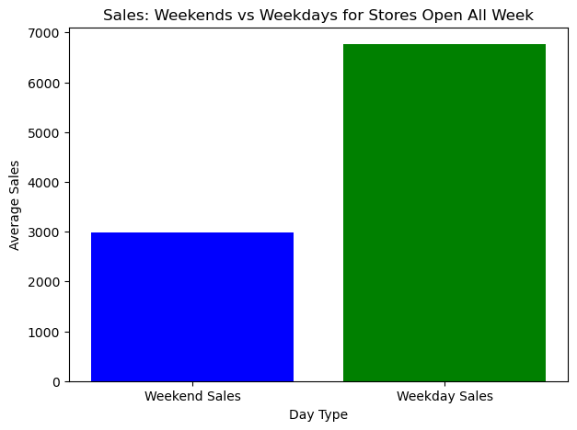
Sales: Weekends vs Weekdays for Stores Open All Week
Weekday Sales (Green Bar): Significantly higher, averaging around ₹7,000. This indicates strong consumer activity during weekdays, possibly driven by regular shopping routines, working professionals making purchases during lunch breaks, or weekday discounts.
Weekend Sales (Blue Bar): Lower, averaging about ₹3,000. This suggests reduced sales over the weekend, which may seem counterintuitive but could be influenced by factors like fewer store visits, reduced operational hours, or customers preferring online purchases when they’re at home.

Slide 10
Task 2 - Prediction of store sales
2.1 Preprocessing
2.2 Building models with sklearn pipelines.
2.3 Choose a loss function
2.4 Post Prediction analysis
2.5 Serialize models

Slide 11
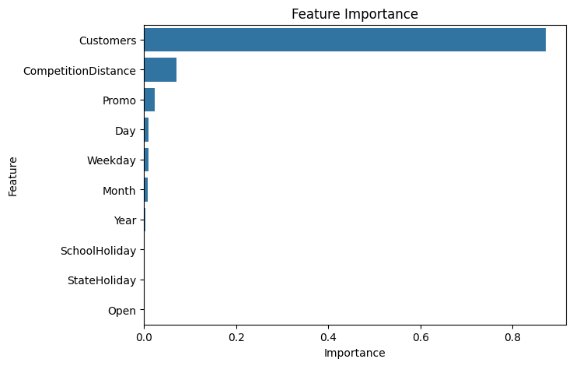
Feature Importance
Customers: This feature dominates the chart, with an importance score near 1.0. It means that the number of customers visiting a store is by far the strongest predictor of sales which is intuitive, as more footfall usually correlates with more revenue. Competition Distance: The second most influential factor. Stores located farther from their competitors may have a competitive advantage, which contributes positively to sales prediction. Promo: Active promotions also play a noticeable role, but not as dominant as expected—possibly due to interactions with other features like holidays or customer volume.

Slide 12
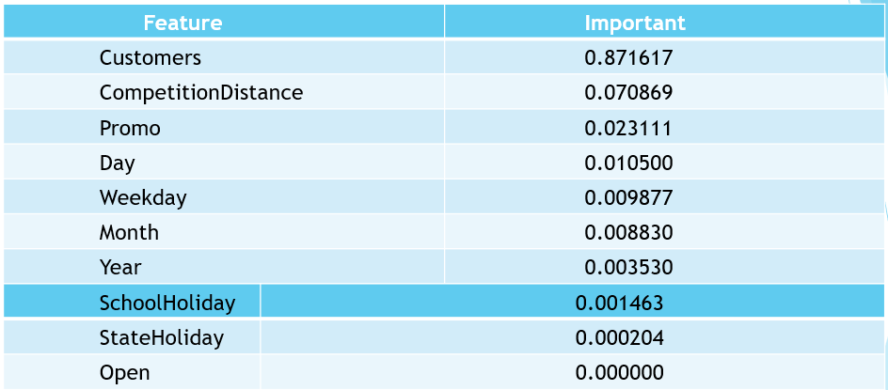
Top 10 features

Slide 13
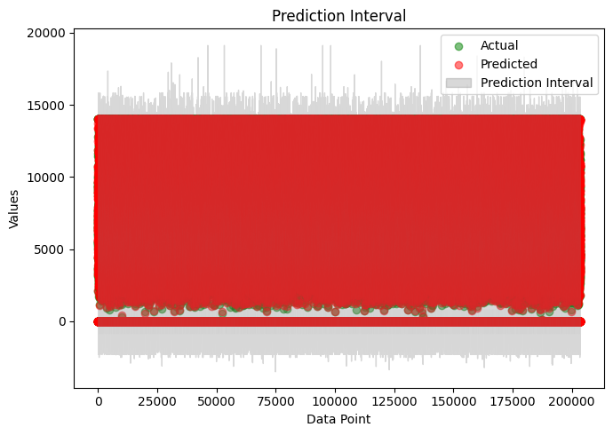
Prediction Interval
Green Dots: Represent the actual store sales data points.
Red Dots: Show the predicted sales values generated by the forecasting model.
Gray Area: Indicates the prediction interval, which provides a range within which the actual sales are expected to fall with a certain level of confidence.
The model predictions (red dots) closely follow the actual values (green dots), suggesting a reasonable prediction performance.
The wide gray interval shows the uncertainty in prediction across all data points. In this chart, the interval appears quite broad, indicating high variability or model uncertainty.
A large dataset is used, as shown by the high number of data points on the X-axis (up to 200,000).

Slide 14
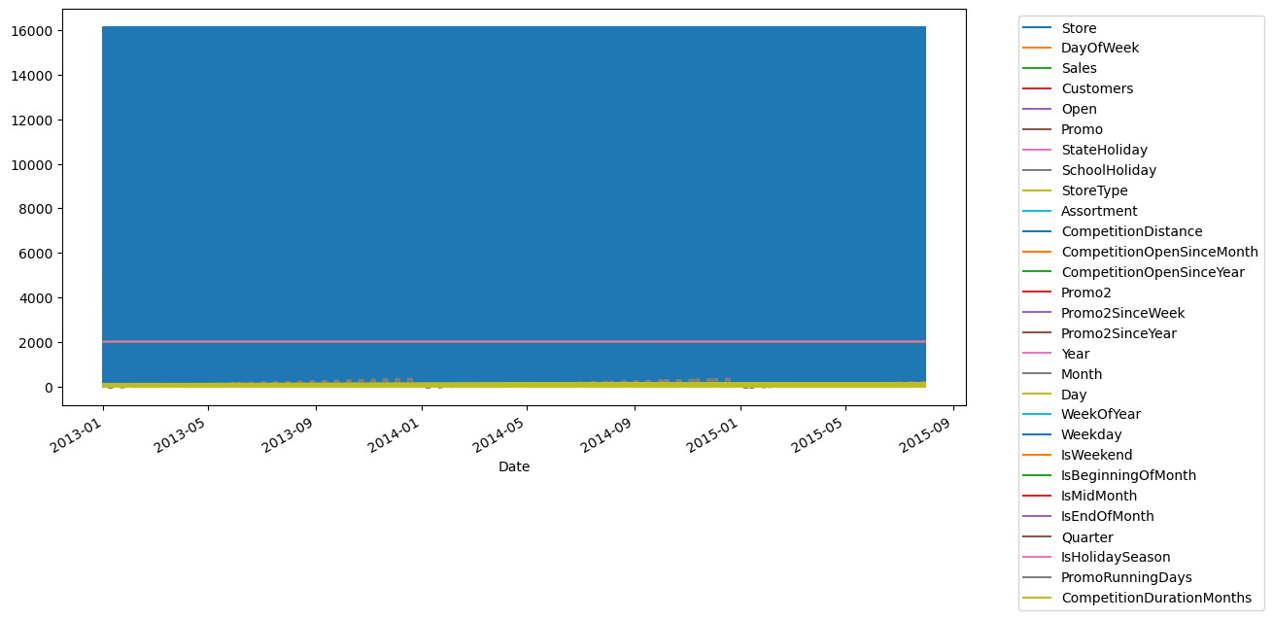
Task - 2.6 Building model with deep learning
Data in Timeseries
Breakdown of the Components
X-Axis (Horizontal): Time series axis starting from Jan 2013 to Sep 2015.
Y-Axis (Vertical): Scaled or normalized values of different features.
Stacked Layers: Each layer represents a feature from the dataset such as:
Core performance metrics: Sales, Customers, Promo, Open
Holiday indicators: SchoolHoliday, StateHoliday
Store-level characteristics: StoreType, Assortment, CompetitionDistance, Promo2, etc.
Time-related variables: Month, WeekOfYear, Quarter, Year, IsWeekend
Promotional campaigns: Promo2SinceWeek, PromoRunningDays
Competition timing and duration: CompetitionOpenSinceMonth, CompetitionDurationMonths

Slide 15
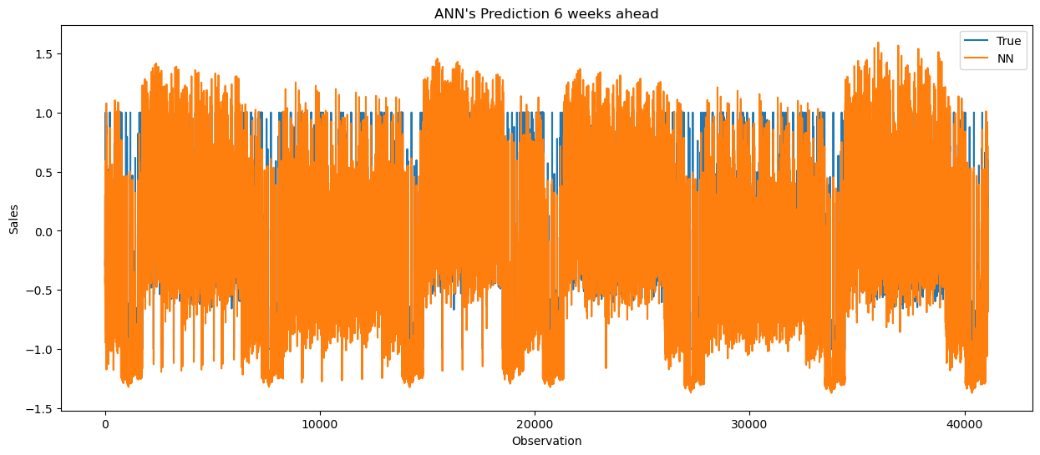
Prediction 6 weeks ahead
Likely corresponds to time-indexed datapoints (day-by-day or week-by-week).
The plot ranges approximately from 0 to 40,000, indicating a large volume of observations.
This scale implies that the data has been standardized or normalized before being fed into the ANN for better training convergence and performance.
Lines in the Plot
Blue Line (True Sales):
Represents the actual ground truth values from the test set.
It’s the benchmark for how well the model is performing.
Orange Line (Predicted Sales by ANN):
These are ANN’s predictions made six weeks ahead of the target dates.
It attempts to anticipate the actual trend as accurately as possible.

Slide 16
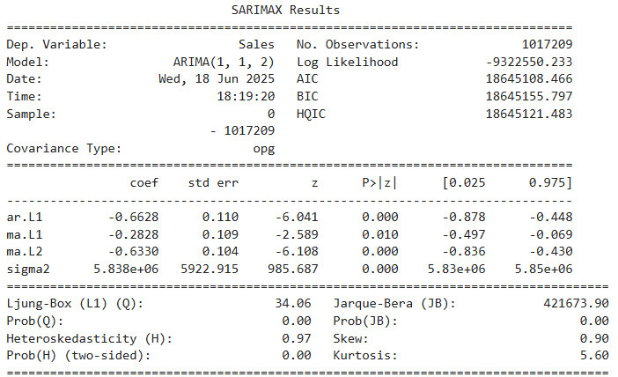
Summary of model
Layer (type) | Output Shape | Param #
dense (Dense) | (None, 12) | 348
dense_1 (Dense) | (None, 1) | 13
Total params: 1,085 (4.24 KB)
Trainable params: 361 (1.41 KB)
Non-trainable params: 0 (0.00 B)
Optimizer params: 724 (2.83 KB)

Slide 17
.
CONCLUSION !
The sales forecasting project successfully implemented machine learning models to predict future sales across multiple retail stores. The model captured seasonal trends, store-specific behaviors, and external factors to generate accurate forecasts. A user-friendly interactive dashboard was developed to allow real-time predictions for any store on any selected date. These insights empower businesses to: Optimize inventory planning Improve resource allocation Design effective promotional strategies Enhance overall operational efficiency Provide both short-term (6-week) and long-term sales forecasts Final Note This sales forecasting system bridges the gap between raw sales data and business intelligence, helping companies move from reactive to proactive planning. It is a powerful tool for retail growth, built on data science, automation, and strategic foresight. THIS IS BIG UNDERSTANDING TELECOME DATA FOR GROWTH KNOWLEDGE AND EXPERIENCE . THANKS FOR NEXT HIKES IT SOLUTION FOR GIVEN THIS PROJECT.

Slide 18
THANK YOU

